Slide 1
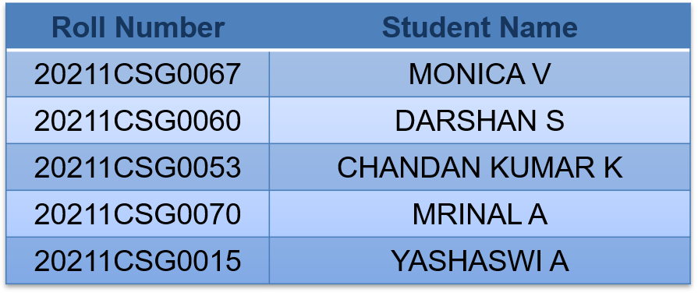
Finger Vein Authentication Using Siamese Networks and Autoencoders
PIP2001 Capstone Project
Final Viva Voce
Batch Number: CSG – G06
Under the Supervision of
Dr. Madhusudhan M V
Professor/Associate Professor /Assistant Professor
School of Computer Science and Engineering
Presidency University
Name of the Program: B.Tech
Name of the HoD:
Name of the Program Project Coordinator:
Name of the School Project Coordinators: Dr. Sampath A K / Dr. Abdul Khadar A / Mr. Md Ziaur Rahman

Slide 2
Introduction
Biometric authentication uses unique physical or behavioral traits to verify identity, offering greater security compared to passwords or PINs, which can be stolen or forgotten. This approach ensures authentication is inherently tied to the individual, making it reliable for applications like banking and access control.
Finger vein authentication leverages near-infrared imaging to capture unique vein patterns beneath the skin. These patterns are highly distinctive and nearly impossible to forge. Since veins are internal, they remain unaffected by surface damage or duplication, providing a secure and tamper-proof solution.
Benefits Over Other Biometrics: 1.Resilience to Environmental Factors: Unlike fingerprints or facial recognition, it isn’t affected by dirt, cuts, lighting, or expressions. 2. Intrinsic Uniqueness: Vein patterns are internal and unique, even among identical twins, enhancing reliability and security.

Slide 3
Research Gaps Identified
Limited accuracy in existing methods under varied conditions
Dependence on large, high-quality datasets.
High computational requirements for real-time applications
Lack of robustness against spoofing.

Slide 4
Proposed Method
Combination of Siamese Networks and Autoencoders:
Autoencoders compress and denoise images, retaining essential features.
Siamese Networks compare vein patterns to determine similarity.
Steps :
1. Image acquisition using infrared imaging.
Preprocessing for noise reduction.
Feature extraction via autoencoders.
Similarity measurement using Siamese Networks.
Decision-making based on Euclidean distance.

Slide 5
Objectives
Develop a secure and robust finger vein authentication system.
Achieve high accuracy (above 95%) and low false acceptance/rejection rates.
Optimize computational efficiency for resource-constrained environments.

Slide 6
System Design and Methodology
Architecture:
Infrared imaging for image acquisition.
Gaussian blur for preprocessing.
Autoencoders for latent feature extraction.
Siamese Networks for similarity measurement.
Technologies Used: Python 3.9, TensorFlow, OpenCV.

Slide 7
Timeline of Project
Review 0
Review 1
Review 2
Review 3
Review 4
Review
Initiation
Planning
Designing
Testing
Title Selection, Github repo creation,
Requirement Gathering
Requirement Analysis, Research and literature review
System design and Architecture planning
Checking for error and debugging to check for bugs
Final Viva Voce

Slide 8
Expected Outcomes
Accuracy: 97% using Siamese Networks, surpassing CNN (92%) and SVM (85%).
SSIM Score: 0.95, ensuring high image similarity retention.
Efficiency: Medium parameter count (20M) optimized for resource-limited environments.
Use Case: Secure applications like banking and access control

Slide 9
Conclusion
Finger vein authentication using Siamese Networks and Autoencoders offers:
High accuracy and resistance to counterfeiting.
Robust feature extraction through preprocessing and autoencoders.
Reliable decision-making via similarity measurement.
Challenges: Computational complexity and dataset quality requirements.
Future Work: Implementing lightweight models for mobile and edge devices.

Slide 10
References
Park et al. (1997): Hand vein patterns for personal identification.
Qin et al. (2017): Deep learning for vein verification.
Madhusudhan M V (2019, 2021): Secure human authentication using vein patterns.
Koch et al. (2015): Siamese Networks for one-shot image recognition.

Slide 11
Thank You

